Slide 1

MACHINE
INTELLIGENCE
Support Vector Machine
K.S.Srinivas
Department of Computer Science and Engineering

Slide 2

MACHINE INTELLIGENCE
Support Vector Machine
K.S.Srinivas
Department of Computer Science and Engineering

Slide 3
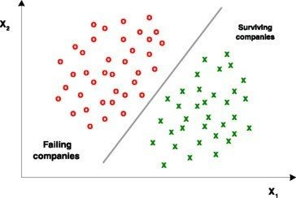
MACHINE INTELLIGENCE
Support Vector Machine
This is one of the most sophisticated yet simple to implement to algorithms.
Support Vector Machines is largely thought of as a linear classifier.
Certain myths about SVMs
Linear Classifier -> Nope it can handle non-linearity as well
Single linear Classifier -> We would do multi – classification
Classifier-> It can do regression as well
SVM are computationally expensive -> with the right C and γ they work like charm
Not a myth – Math heavy and fundamentally provable
A data set is said to be linearly separable if we can have a hyper plane that cans separate them.

Slide 4
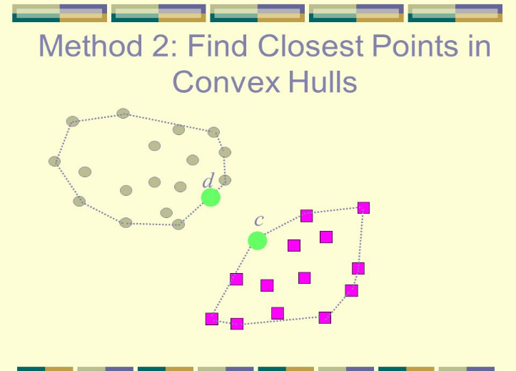


MACHINE INTELLIGENCE
Linearly Separable Data
Lets look at this Euclidean plane with 2 sets of data points.
The line that separates them is the decision boundary.
In a 3 dimensions that would be a plane
These points that are separable usually form a convex hull

Slide 5
MACHINE INTELLIGENCE
Example of Linearly Separable Data
But we know that are many planes that can separate these instances
The real question is which of these planes is the best
You can see that the green line seems to be the best – Why?
Because the green line seems to be the farthest away from the closest points

Slide 6
MACHINE INTELLIGENCE
Example of Linearly Separable Data
But we know that are many planes that can separate these instances
The real question is which of these planes is the best
You can see that the green line seems to be the best – Why?
Because the green line seems to be the farthest away from the closest points
These points marked in red play a role in defining the hyper plane
These are the
Support Vectors

Slide 7
MACHINE INTELLIGENCE
Hyper planes
So the cool thing is this plane separate the instance set maximally.
Lets draw this plane H0 that separates them maximally – Say the median ( as in road median)
Lets also draw equidistant margin H1 and H2 such that
The margins are parallel to the median ( aka the gutter)
The closest points on either side lie on the margin
Our goal now simplifies to making the distance say 2d ( sum (d1+d2) ) as large as possible
SVM is a maximum margin classifier – one of the most elegant ideas that have come about in computer science
H₁
H₂
H₀
w.x+b=1
w.x+b=0
w.x+b=-1

Slide 8
MACHINE INTELLIGENCE
Hyper planes
A ‘N’ number of hyper planes can be traced between data which can be linearly separable.
There are 3 significant hyper planes defined namely , H0 which acts as a median to H1 and H2 hyper planes which are the closest to the data sets on both planes such that the margin between them is maximum.
The distance between the two extreme hyper planes can be given by ‘2d’
H₁
H₂
H₀
d+
d-
w.x+b=1
w.x+b=0
w.x+b=-1

Slide 9
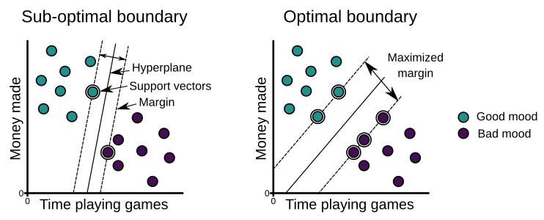
MACHINE INTELLIGENCE
Optimal vs Sub optimal
We saw some equations earlier around these medians and margins but let the geometry sink in a little

Slide 10
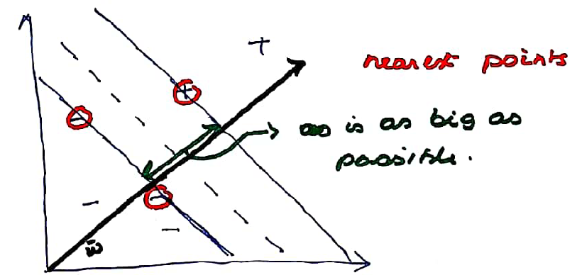
MACHINE INTELLIGENCE
Geometry of the Median
Lets draw this line w perpendicular to the street ( perforce median and gutter)
Lets also insist that the closest points lie on the margins(gutters)
Our Goal as stated before is to make the street as big as possible
We don’t know anything about the length of the vector w

Slide 11
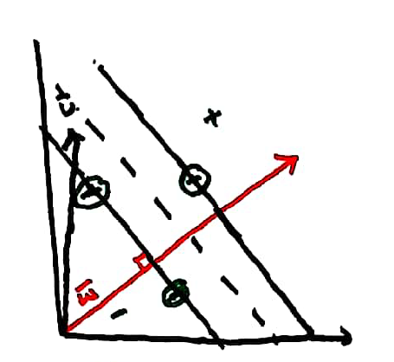

MACHINE INTELLIGENCE
Finding the distance of an unknown point
Lets get an unknown vector u
We know quite intuitively that the point is either a + sample or a – sample by looking at the projection of u on w
The farther u is on the right side of w we know it is a + sample and a –ve sample other wise
To compute how far it is on w all we need to do
Is take a dot product of w.u which is a scalar quantity
Lets actually insist that for it to be a + sample it must

Slide 12
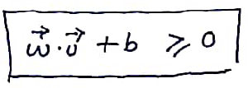

MACHINE INTELLIGENCE
Creating our decision rule
So our decision rule is
Without any loss of generality we can say
This is our decision rule 1/5 which we will use for our final equation

Slide 13

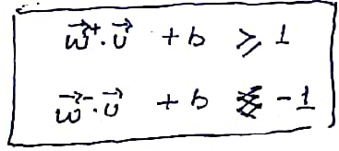
MACHINE INTELLIGENCE
Enhancing our decision Rule
Our Decision rule is
We are not just going to leave the decision rule but make it HARD
We insist that for all + samples that the decision rule must be >= 1
We insist that for all – samples that our decision rule must be <= -1
+ve
-ve

Slide 14

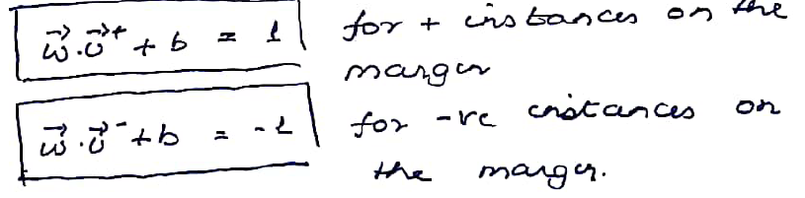
MACHINE INTELLIGENCE
Defining the margins
Lets also harden the margins by saying for the margins the equations are exactly +1 and -1
Therefore the equations of the points on margins are

Slide 15
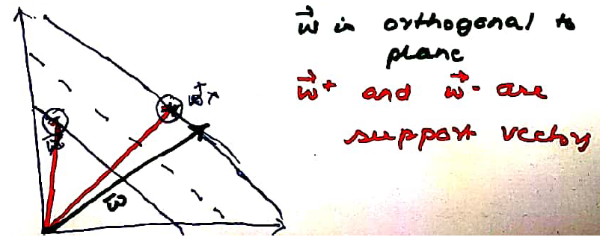
MACHINE INTELLIGENCE
Defining the Support Vectors
The samples on the margins are the support vector that satisfy the equations

Slide 16
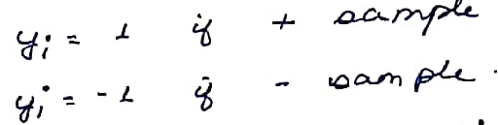
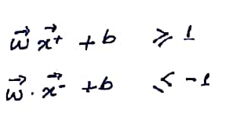
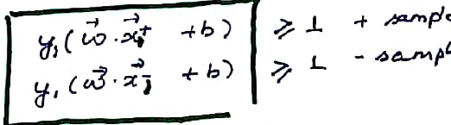
MACHINE INTELLIGENCE
A mathematical convenience
Lets introduce another quantity y_{i} for every instance .
The property of y_{i} that for every sample is
This could help us in rewriting our equation as for all +ve and –ve samples as
Not a mistake

Slide 17
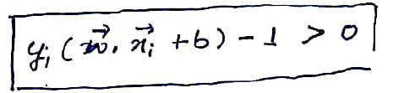
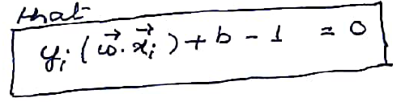
MACHINE INTELLIGENCE
Some rearrangements
Lets move 1 to the left
That would make the equation to for all + and – samples
But for all instance that lie in the gutter we will insist that the equation must exactly be equal to 0

Slide 18
MACHINE INTELLIGENCE
Lost track??
Our original problem was to find a street that maximally separated the samples
i.e as we break it down
Find margins
Maximize the street
AND NOW LET THE MARGINS BE CONSTRAINED BY

Slide 19
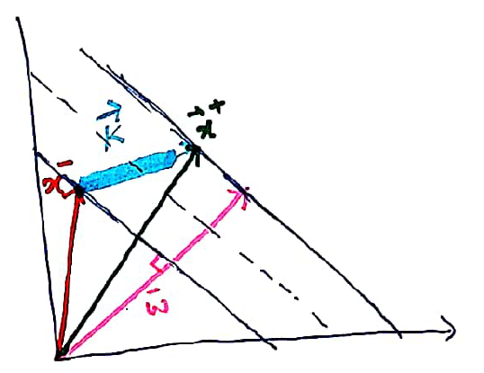
MACHINE INTELLIGENCE
Lets find the quantity we want to maximize
If we have a x- on the margin and another x+ on the other margin
The difference between these 2 vectors is (x+ - x-) as indicated by the blue indicates the width of the street
These would need to be projected onto the vector w

Slide 20
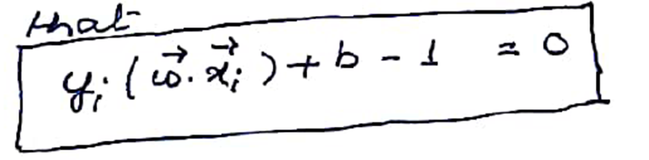
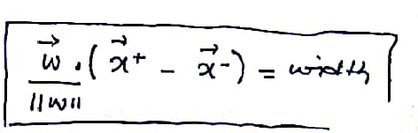


MACHINE INTELLIGENCE
Lets compute the margin
We known that for + support vector the equation ( y_{i}=+1)
We known that for - support vector the equation (y_{i}=-1)
What we want to compute is
We have just made the vector W an unit vector

Slide 21
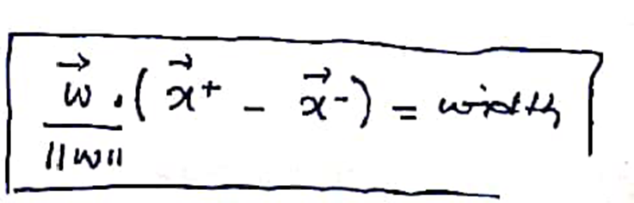
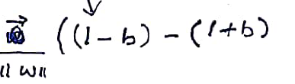
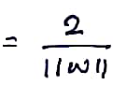
MACHINE INTELLIGENCE
Lets simplify the equation
y_{i}=-1
y_{i}=+1
That gives us the margin to maximized as

Slide 22




MACHINE INTELLIGENCE
Lets add some more mathematical convenience
We wish to maximize
Which is the same as minimizing
Subject to
This is the primal form

Slide 23
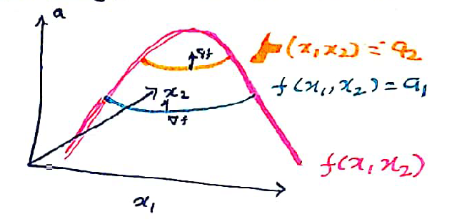
MACHINE INTELLIGENCE
A small detour into constrained optimization
Lets say there is a function f(x1,x2) that we wish to maximize subject to a function g(x1,x2) = c
Please note the equality constraint which will need to be relaxed later.
We need to take the ∇f which gives us the steepest direction
Let us visualize the plot f = a1 all along the blue line and f=a2 along the orange line
The function f being represented by the pink line

Slide 24
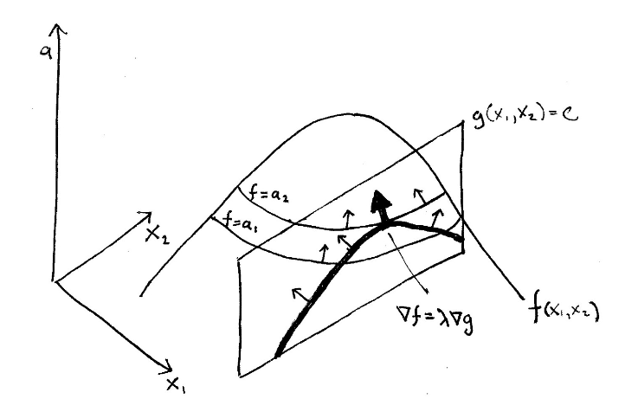
MACHINE INTELLIGENCE
Constrain added in
We start climbing the hill moving from left to right on the constraint curve
At each point we check ∇g and check ∇f
When ∇g > ∇f we keep moving
At a point where ∇g = ∇f we have reached the maximum
Any further move will result in declining f

Slide 25
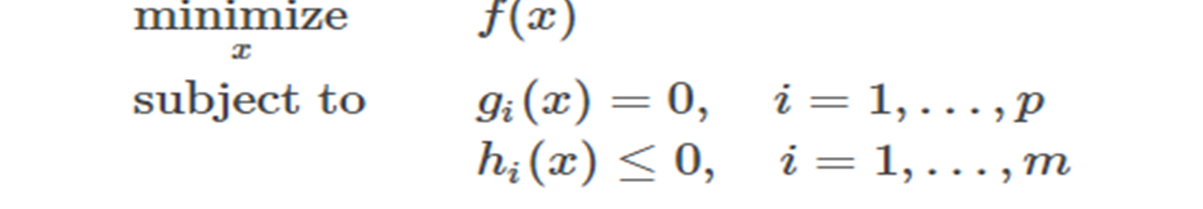


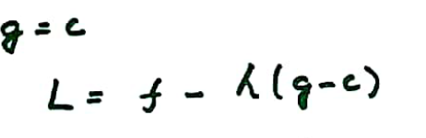
MACHINE INTELLIGENCE
Constrain added in
We can rewrite
Algorithm
Construct the Lagrangian
One Lagrangian multiplier per constraint
Which means one α per instance
Compute ∇L
Set ∇L = 0 and solve for this

Slide 26
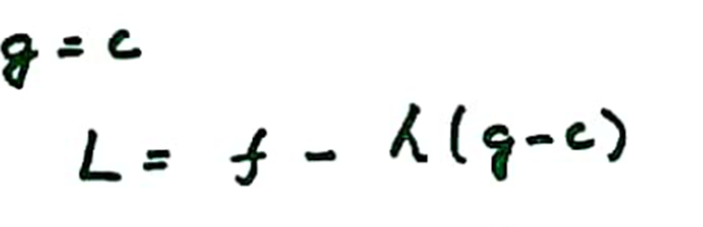
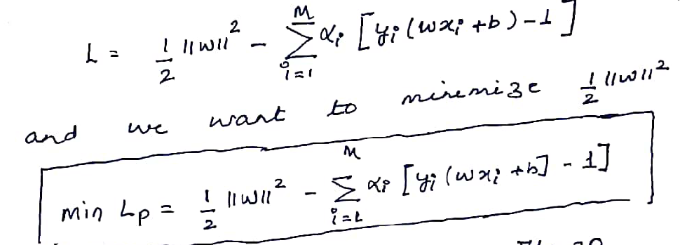
MACHINE INTELLIGENCE
Final Lagrangian
Which for our problem is

Slide 27
MACHINE INTELLIGENCE
So we solve for Dual
It is said that it is easier to solve the dual than the primal
The Lagrangian dual states that instead of solving for minimizing w,b subject to the constraints involving α i.e α>=0
Solve instead by maximizing α subject to the previously defined constraints
What that means is
Define L
Take partials with respect to w and b
Set them to 0
Replace them in the original equation

Slide 28

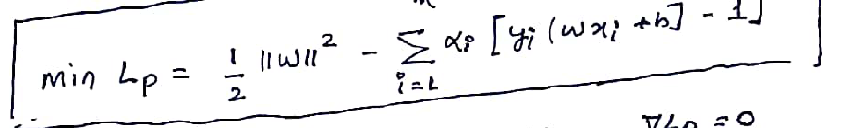
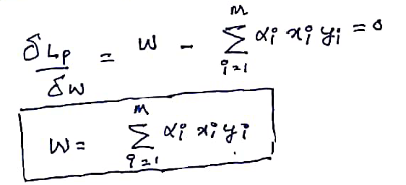
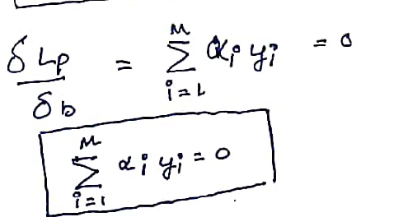
MACHINE INTELLIGENCE
So the solution is...

Slide 29
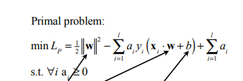
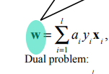

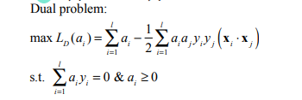
MACHINE INTELLIGENCE
So the solution is...

Slide 30

MACHINE INTELLIGENCE
So the solution is...
The Lagrangian Dual Problem: instead of minimizing over w, b, subject to constraints involving a’s, we can maximize over a (the dual variable) subject to the relations obtained previously for w and b
We will now solve for the
a’s by differentiating the dual problem wrt a, and setting it to zero. Most of the a’s will turn out to have the value zero. The non-zero a’s will correspond to the support vectors
By substituting for w and b back in the original eqn we can get rid of the dependence on w and b.
Note first that we already now have our answer for what the weights w must be: they are a linear combination of the training inputs and the training outputs, xi and yi and the values of a

Slide 31
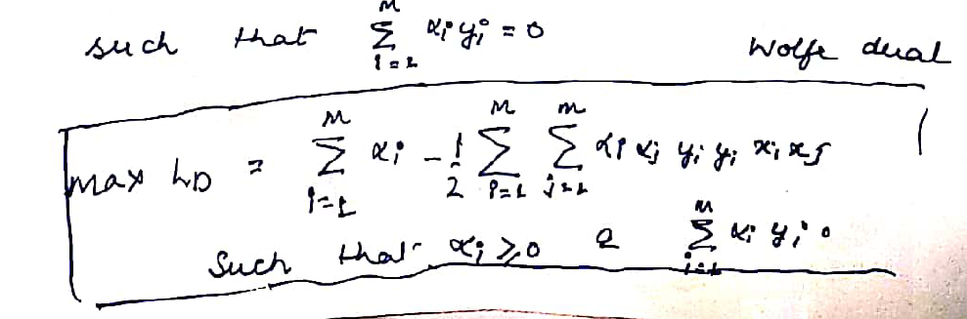
MACHINE INTELLIGENCE
Wolf Dual replacement
Which when we replace we get Wolfe Dual – - Straightforward

Slide 32
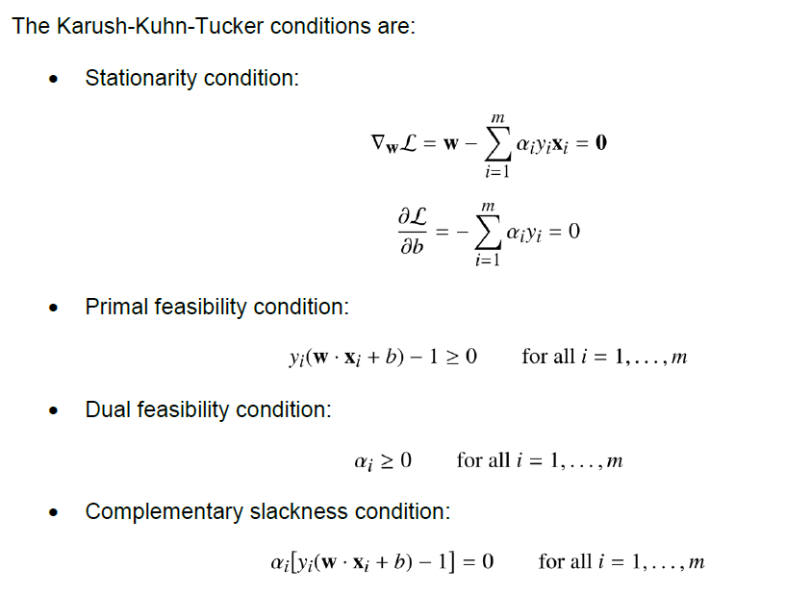
MACHINE INTELLIGENCE
KKT
Slack condition gives us the formulation that for all points other than the support vectors alpha is 0
Since KKT is satisfied we have g = 0 changed to g > 0 as the solution

Slide 33
THANK YOU
K.S.Srinivas
srinivasks@pes.edu
+91 80 2672 1983 Extn 701

